Slide 1
Fiat-Shamir and the Quantum Forking Conjecture
Dominique Unruh
University of Tartu

Slide 2
Fiat-Shamir (overview)
Non-interactive proof system:
Zero-knowledge proof of knowledge
Signature scheme (Signer proves knowledge of sk)
Quantum secure?
Prover
$$com,H\left(com\right),resp$$
Verifier
statement
witness
statement
Verifier learns “nothing”
Prover must know witness

Slide 3
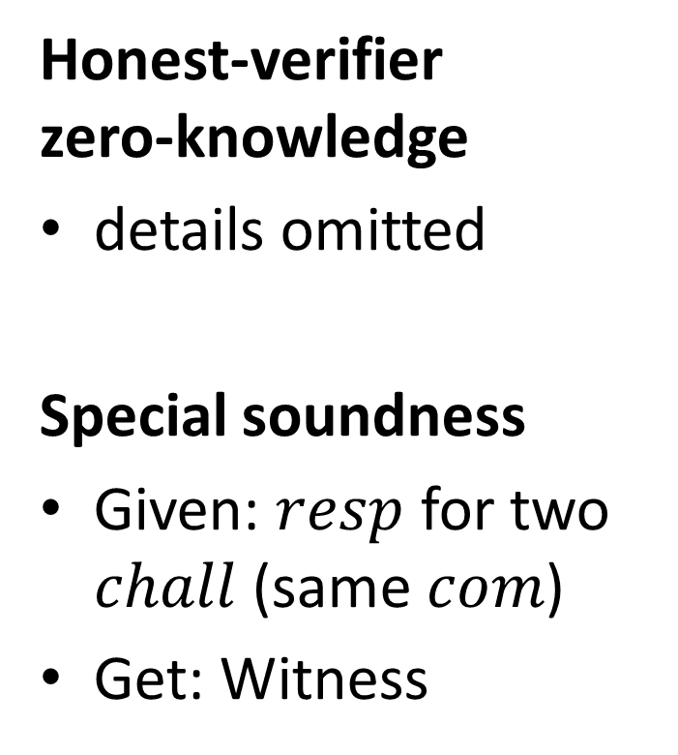
Understanding FS: Sigma protocols
Interactive proof system
Honest-verifier zero-knowledge
details omitted
Special soundness
Given: $resp$ for two $chall$ (same $com$)
Get: Witness
P
V
commitment
challenge
response

Slide 4
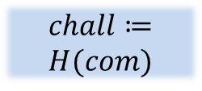
Understanding FS: The construction
Prover
Verifier
Prover sends simulated sigma-proto interaction
→ Soundness of sigma-protocol carries over
P
$$com$$
V
$$chall≔ \\ H(com)$$
$$com,chall,resp$$
$$chall$$
$$resp$$

Slide 5
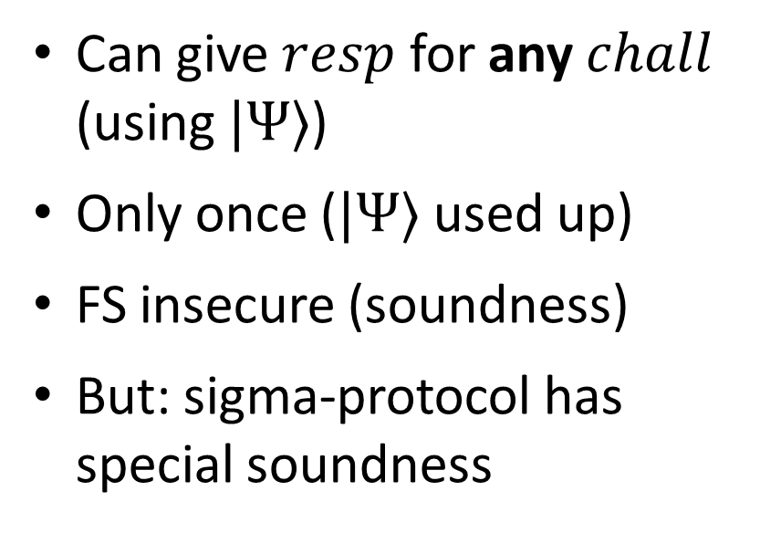
Breaking FS soundness (quantum)
Artificial sigma-protocol [Ambainis,Rosmanis,U14] (relative to specific oracles)
P
Can give $resp$ for any $chall$ (using $|Ψ〉$)
Only once ($|Ψ〉$ used up)
FS insecure (soundness)
But: sigma-protocol has special soundness
$$comm$$
$$|Ψ〉$$
$$chall$$
$$resp$$

Slide 6
Breaking FS soundness (quantum)
FS not secure in general
For quantum attackers
Relative to specific oracles
Ways out:
Non-relativizing proofs? Doubtful.
Other protocols? Yes. [U15]
Extra conditions on sigma-protocol? This talk.

Slide 7

Fixing FS: Strict soundness
Special soundness
Given: $resp$ for two $chall$ (same $com$)
Get: Witness
Strict soundness
Given $com$, $chall$, exists at most one $resp$
P
V
commitment
challenge
response
Honest-verifier zero-knowledge

Slide 8
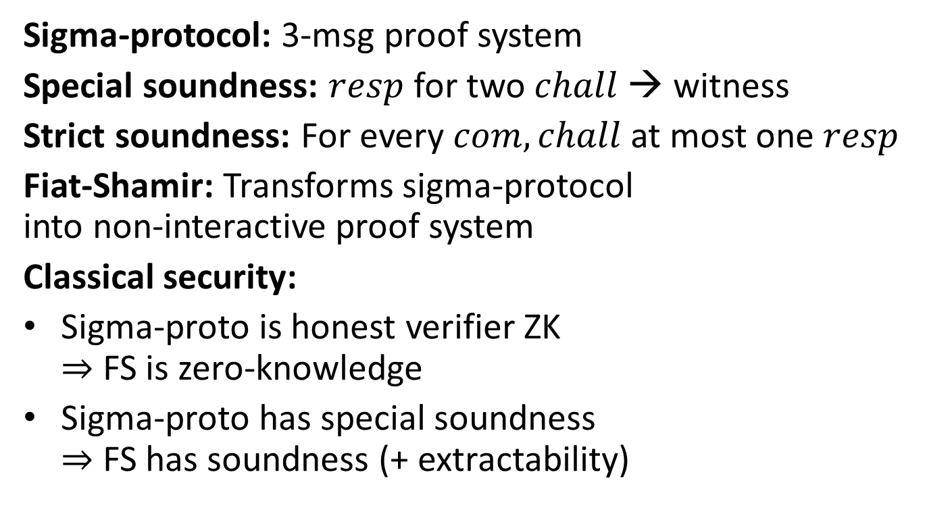
Recap / preview
Sigma-protocol: 3-msg proof system
Special soundness: $resp$ for two $chall$ → witness
Strict soundness: For every $com,chall$ at most one $resp$
Fiat-Shamir: Transforms sigma-protocol into non-interactive proof system
Classical security:
Sigma-proto is honest verifier ZK $⇒$ FS is zero-knowledge
Sigma-proto has special soundness $⇒$ FS has soundness (+ extractability)
Quantumly?
✔
+ strict soudness
(✔)

Slide 9
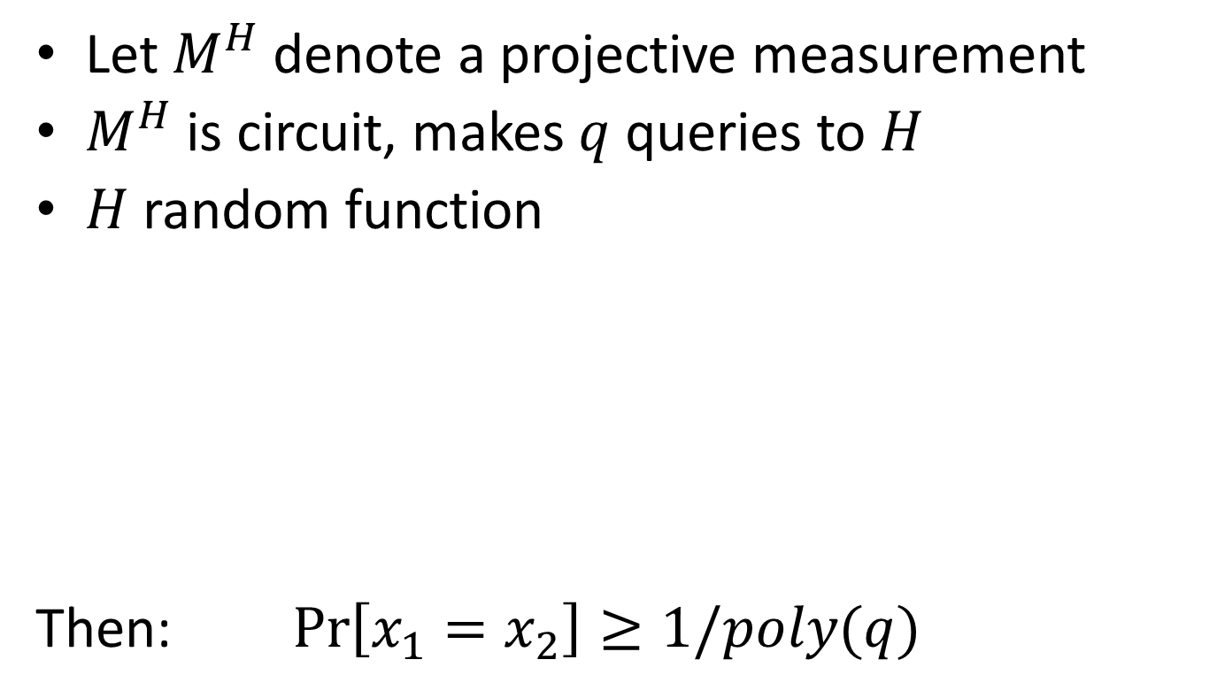
Quantum Forking Conjecture
Let $M^{H}$ denote a projective measurement
$M^{H}$ is circuit, makes $q$ queries to $H$
$H$ random function
Then: $\operatorname{Pr}\left[x_{1}=x_{2}\right]≥1/poly(q)$
$M^{H}$
$$H\left(x_{1}\right)≔rand$$
$M^{H}$
$$|0〉$$
$$x_{1}$$
$$x_{2}$$
True for classical $M^{H}$

Slide 10
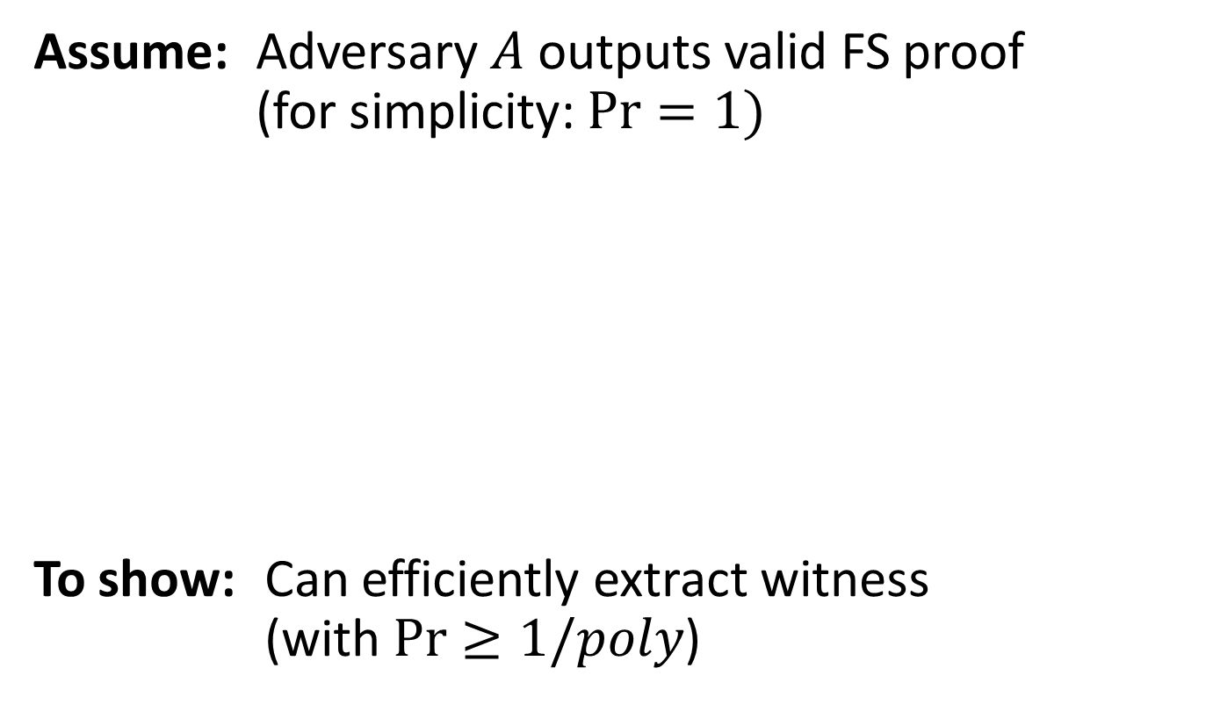
Proving FS soundness
Assume: Adversary $A$ outputs valid FS proof (for simplicity: $\operatorname{Pr}{=1})$
To show: Can efficiently extract witness (with $\operatorname{Pr}{≥1/poly}$)
$A$
$$state$$
$$com$$
$$chall$$
valid
$$resp$$

Slide 11
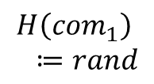
Proving FS soundness (ctd.)
$A$
$$state$$
$A^{∗}$
$A$
$$state$$
$A^{∗}$
$$com$$
$$com$$
$$H\left(com_{1}\right) \\ ≔rand$$
$$chall$$
$$chall$$
Compute witness
$$resp$$
$$resp$$
$$com_{1},chall_{1},resp_{1}$$
$$com_{2},chall_{2},resp_{2}$$
$$com_{1}=com_{2}$$
By special soundness
To show: $\operatorname{Pr}\left[witness correct\right]≥1/poly$

Slide 12
Proving FS soundness (ctd.)
$A$
$$state$$
$A^{∗}$
$A$
$$state$$
$A^{∗}$
$$com$$
$$com$$
$$H\left(com_{1}\right) \\ ≔rand$$
$$chall$$
$$chall$$
$$resp$$
$$resp$$
$$com_{1},chall_{1},resp_{1}$$
$$com_{2},chall_{2},resp_{2}$$
By “strict soundness”
To show: $\operatorname{Pr}\left[com_{1}=com_{2}\right]≥1/poly$

Slide 13
Proving FS soundness (ctd.)
$$M^{H}$$
$A$
$A^{∗}$
$$M^{H}$$
$$state$$
$A$
$$state$$
$A^{∗}$
$$com$$
$$com$$
$$H\left(com_{1}\right) \\ ≔rand$$
$$chall$$
$$chall$$
$$resp$$
$$resp$$
$$com_{1}$$
$$com_{2}$$
Projective measurement
Projective measurement
✔
To show: $\operatorname{Pr}\left[com_{1}=com_{2}\right]≥1/poly$
By QFC

Slide 14
Theorem
Assume: QFC holds
Assume: Sigma-protocol has
special soundness
strict soundness
honest-verifier zero-knowledge
Then: Fiat-Shamir is
a proof of knowledge (simulation-sound extractable)
zero-knowledge

Slide 15
Open problems
Prove QFC (please help! ☺)
Weaker condition than strict soundness?
Sigma-protos with strict soundness

Slide 16
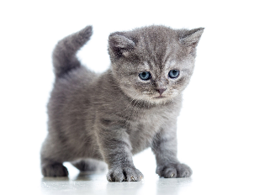
I thank you for your attention
This research was supported by European Social Fund’s Doctoral Studies and Internationalisation Programme DoRa

